Slide 1
Feedback
Found Trace

Slide 2
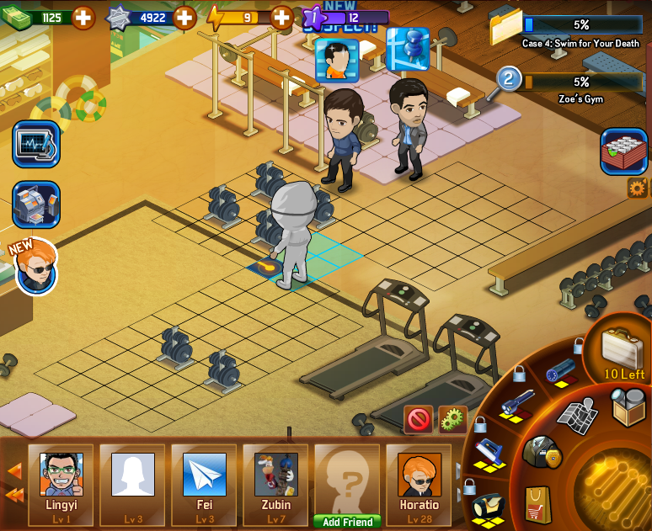
Plan A: Center Screen

Slide 3
Congratulations!
You’ve Found A Trace!

Slide 5
Plan B: Floating Text

Slide 6
Trace Found !

Slide 8
Plan C: Notice UI

Slide 9

C-1: Upper Screen
Congratulations!
You’ve found a trace!

Slide 10
C-2: Lower Screen
Congratulations!
You’ve found a trace!

Slide 11
C-3: Share UI
Congratulations!
You’ve found a trace!

Slide 12
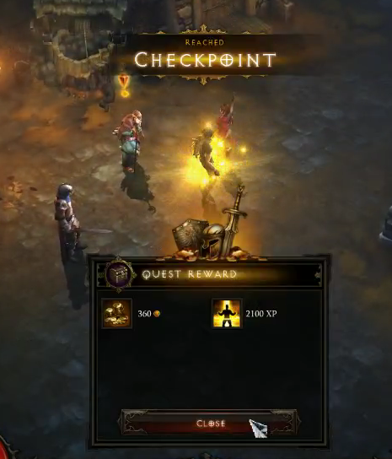
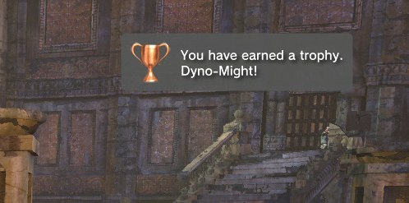
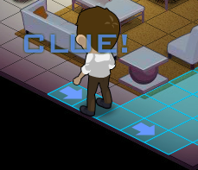
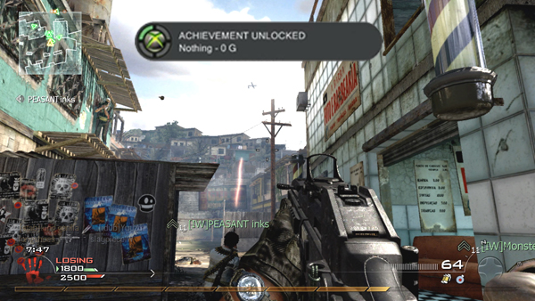
Reference

